Slide 1
Software Security CS 595
Final Presentation
Guidance by: Prof YUE DUAN

Slide 2
Iranian Pupy RAT -
A Malware Analysis
Presented by:
Lavanya Juvvala A20442790

Slide 3
Table of Contents
Introduction and working of Iranian Pupy RAT
Methodology : Phishing Attack
What are Macros?
Working and Setup
Tool: What is OfficeMalScanner?
Execution and Malware Analysis
Observations
Extension: Android
Future work
References

Slide 4
Motivation
What is Pupy RAT?
Pupy is classified as a RAT(Remote Access Trojan).
It is a multi-platform (Windows, Linux, OSX, Android), multi- function RAT and post-exploitation tool mainly written in python.
The whole Python interpreter is fully loaded from memory so there may be little to no trace on the disk of a computer.
Pupy can communicate using multiple transports, load remote python code, python package and python C- extensions from memory.
It could easily be implemented to stay hidden on a system and steal sensitive information as an APT (Advanced Persistent Threat).

Slide 5
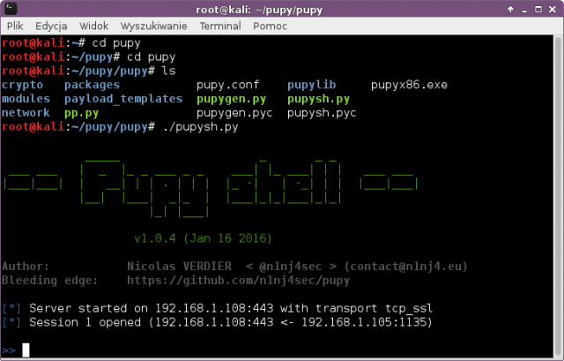

Slide 6
Working
The attackers from COBALT GYPSY group used phishing lures to distribute Iranian PupyRAT.
This was first detected by the Secureworks Counter Threat Team(CTU) in early January 2017.
Victim opens the mail and clicks on the link from the phishing mail and downloads a document on the local system.
The downloaded document attempts to run a macro which in turn runs a PowerShell command.
This command downloads two additional PowerShell scripts that install PupyRAT, an open-source remote access trojan (RAT).
This creates a back-door for the attackers to exploit the victim’s system.

Slide 7
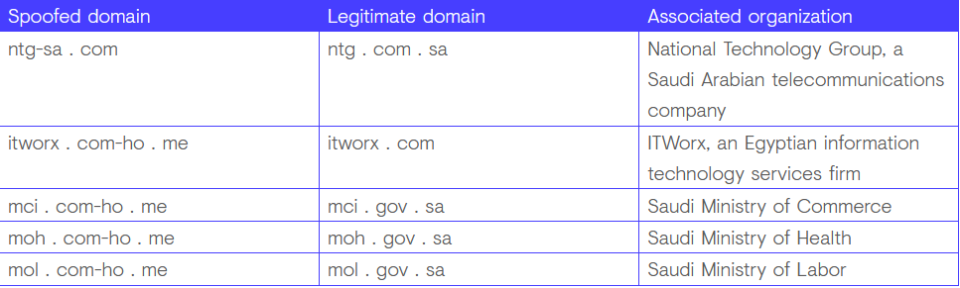
Spoofed Domains

Slide 8
Pupy Rat Effects
Windows specific :
migrate
inter process architecture injection also works (x86->x64 and x64->x86)
in memory execution of PE exe both x86 and x64
webcam snapshot
microphone recorder
mouselogger:
takes small screenshots around the mouse at each click and send them back to the server
token manipulation
getsystem
creddump
tons of useful powershell scripts

Slide 9
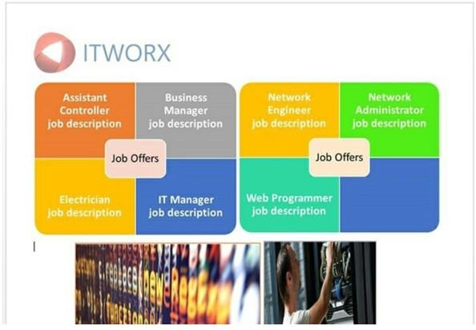
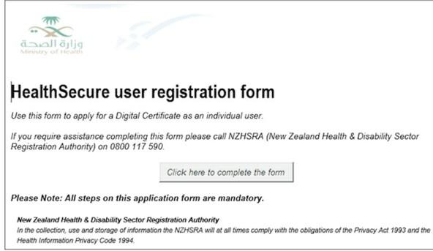
Methodology : Phishing Attack
Screenshots of the malicious emails from the phishing attack.
On clicking these links, a macro which is enabled behind the forms runs few scripts on the victim machine which gives a backdoor to the attacker .

Slide 10
Macros: Definition and Uses
Macro
Macro (which stands for "macro instruction") is a predefined set of commands that will run with the appropriate execution criteria
A shortcut that performs multiple instruction in one step
VB programs can run executables with different additional instructions
Macros can be used to make tasks less repetitive by representing a complicated sequence of keystrokes, mouse movements, commands, or other types of input
Macros are a set of actions that can be used to automate tasks

Slide 11
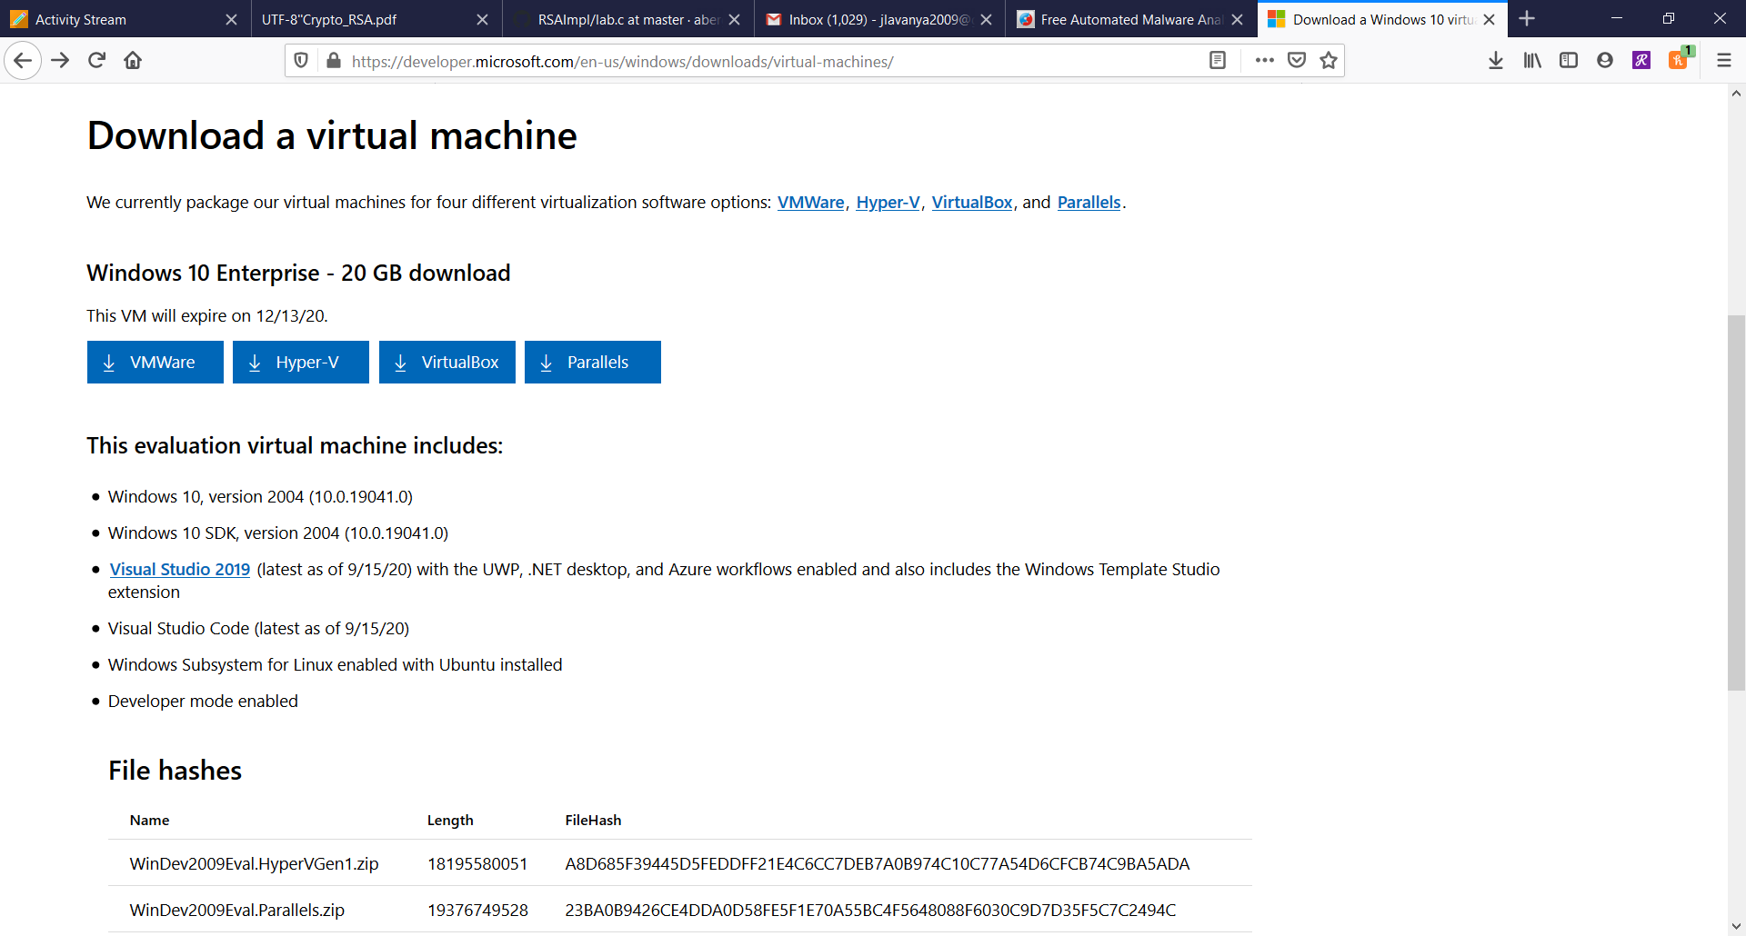
Setup Work Environment
Download WINDOWS 10 Virtual Machine for malware analysis
We have used VMWare for this project

Slide 12
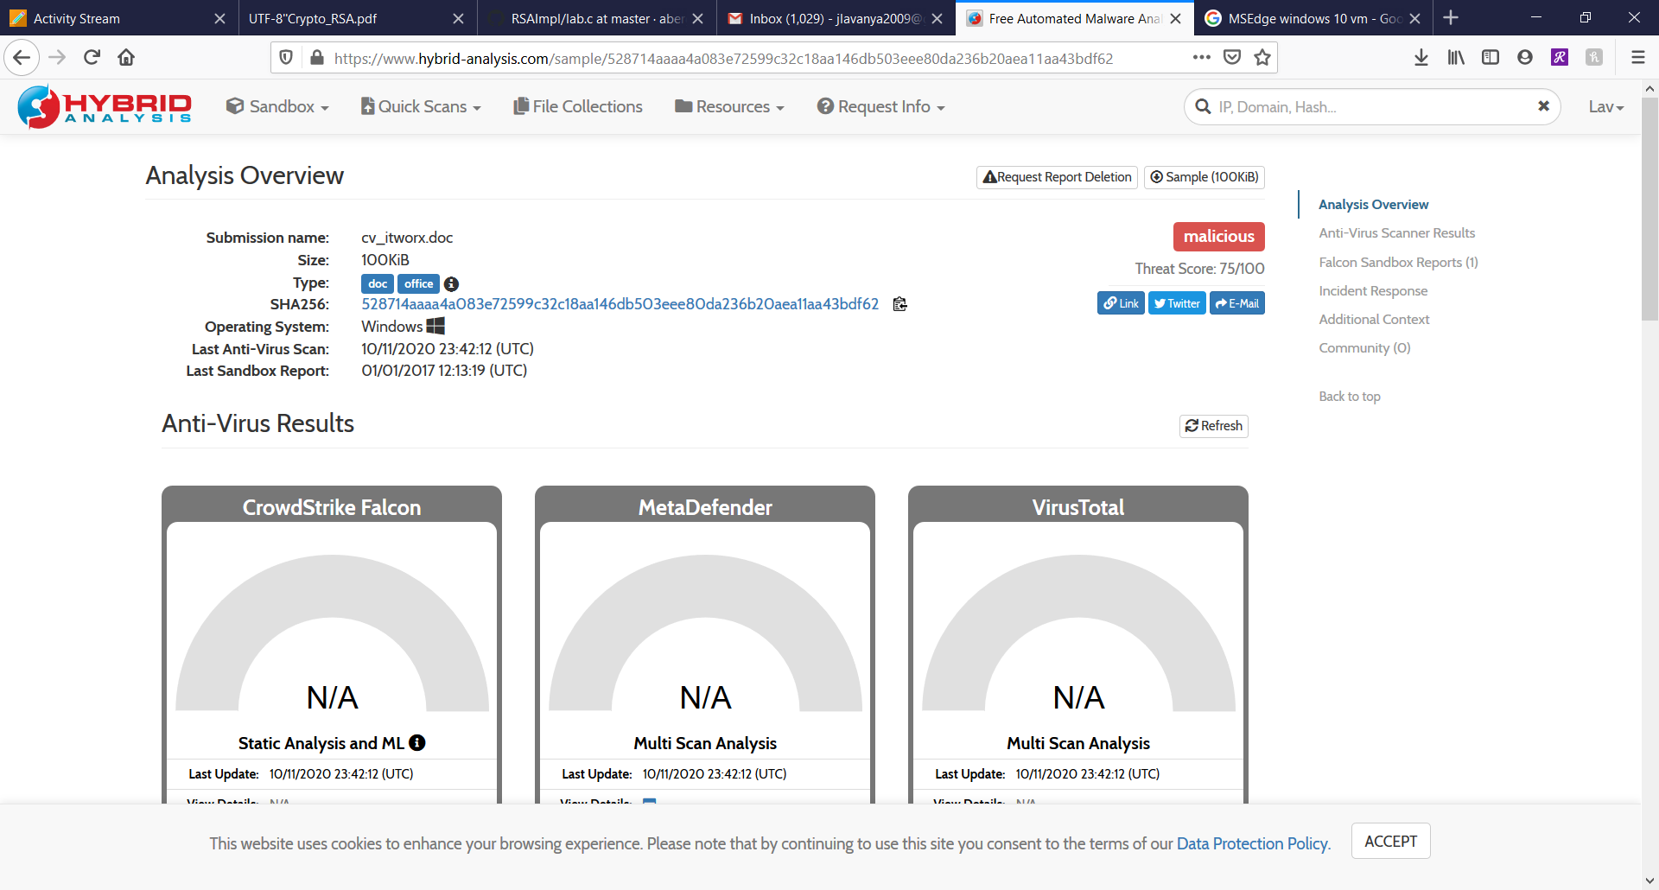
Setup Work Environment
3. Register an account on the Hybrid Analysis website

Slide 13
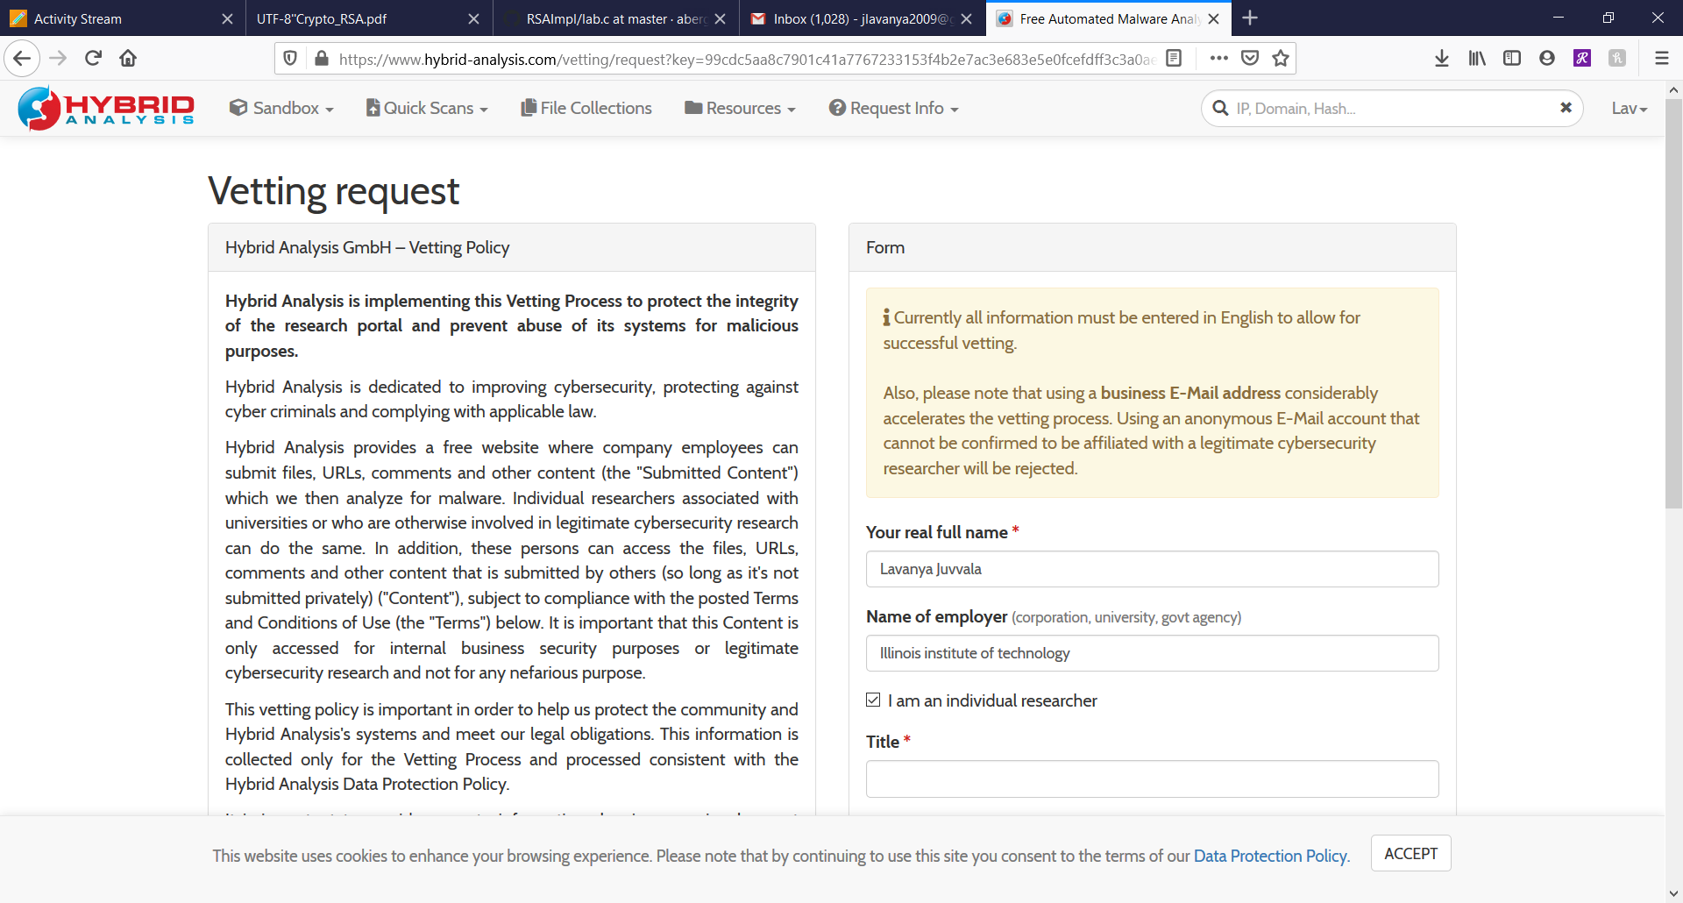
Setup Work Environment
4. Fill in the vetting request and get the approval link to the assigned email.
5. Download the Iranian Pupy Rat malware file on the VM.

Slide 14
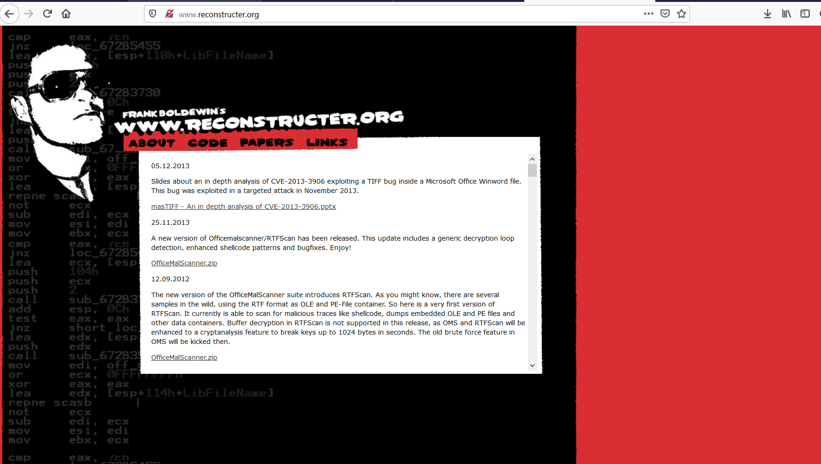
Setup Work Environment
6. Download OfficeMalScanner on the Windows VM from “ reconstrucer.org”

Slide 15
Tools: OfficeMalScanner
Forensic tool to scan Microsoft Office files
It can scan for malicious macros (VBA) and embedded portable executable (PE) files
The tool is suitable for scanning
Microsoft Word (*.doc, *.docx)
Microsoft Excel (*.xls, *.xlsx)
Microsoft Powerpoint (*.ppt, *.pptx)
The toolkit includes
RTFScan
Mal-Host Setup
DisView

Slide 16
OfficeMalScanner : Syntax , Options
Syntax:
OfficeMalScanner <PPT, DOC or XLS file> <scan | info> <brute> <debug>
Options
scan
scan for several shellcode heuristics and encrypted PE-Files
info
dumps OLE structures, offsets+length and saves found VB-Macro code
inflate
decompresses Ms Office 2007 documents, e.g. docx, into a temp dir

Slide 17
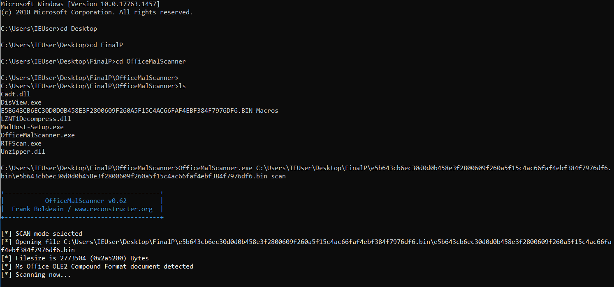
EXECUTION
Run the command prompt
Start OfficeMalScanner and execute the following statements to extract macros
scan option is selected

Slide 18
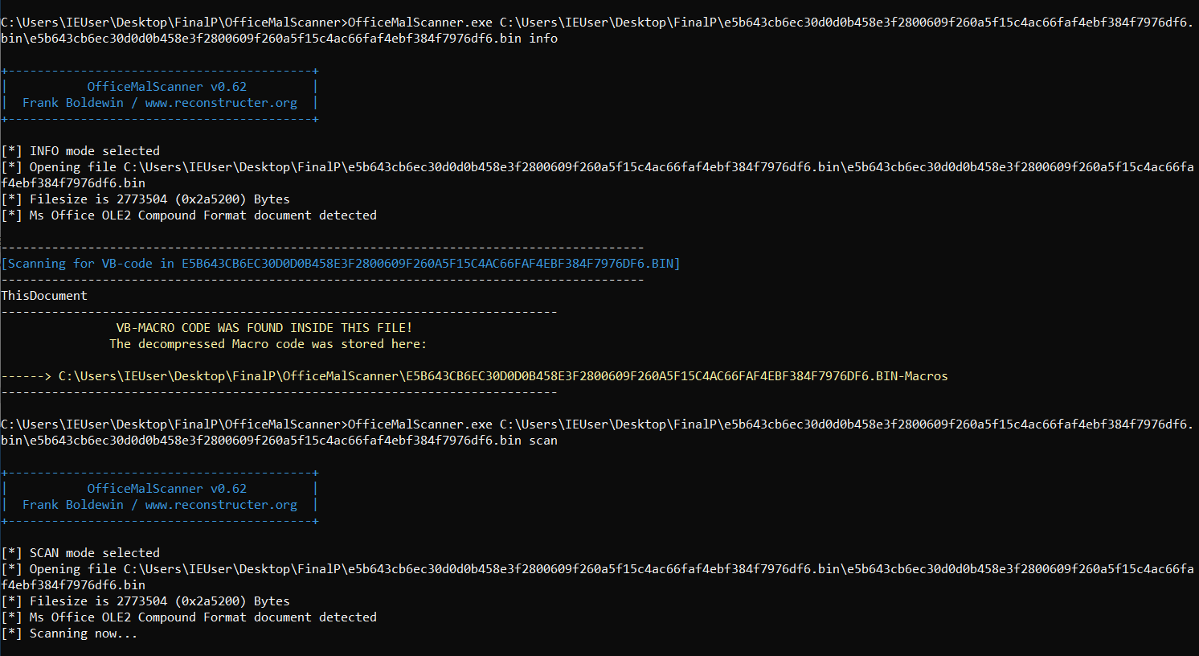
EXECUTION
Info option is selected
info option is selected

Slide 19
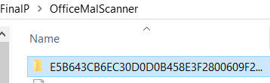
EXECUTION
The decompressed macro code is stored in the OfficeMalScanner folder

Slide 20
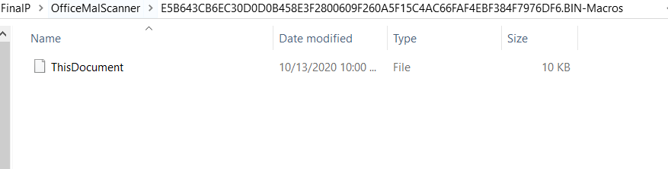
EXECUTION
Inside the above folder, we find the document “ThisDocument” which runs the macros

Slide 21
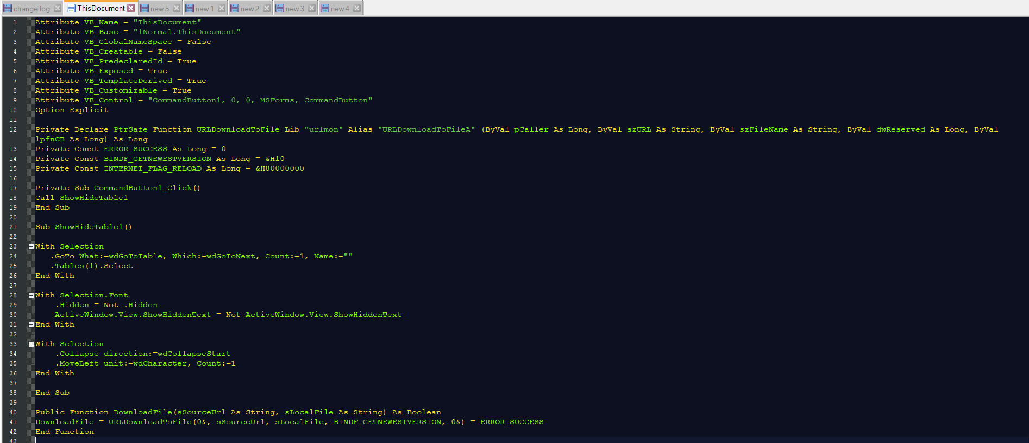
Opening this document in Notepad++ for analyzing, these are the observations:

Slide 22
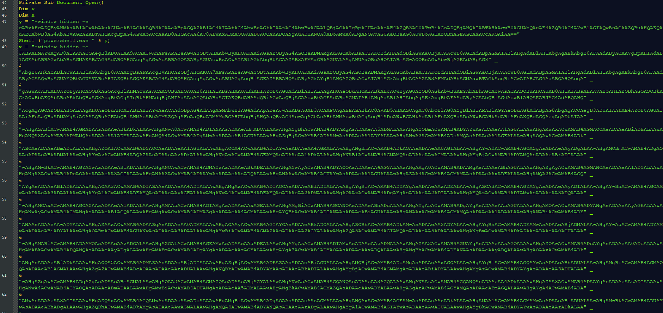

Slide 23
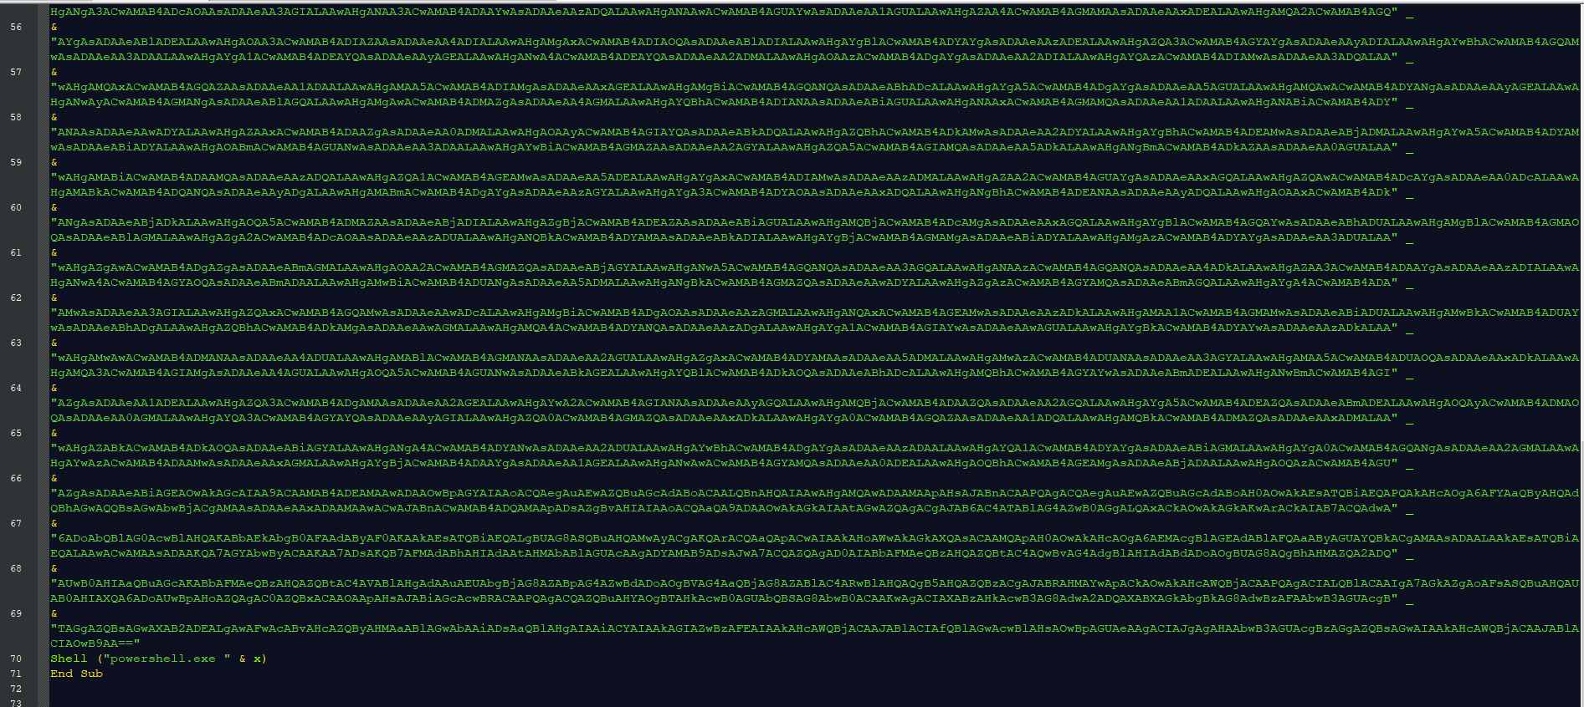

Slide 24
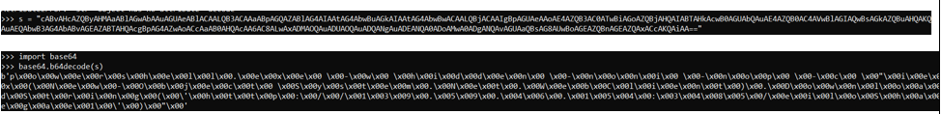
Contributions: Decoding the ‘y’ Code
Decoded the strings assigned to the parameters in base64 using Python.
On observing the decoded string, it can be inferenced that powershell script is encoded with UTF-16 before encoding with utf-64 . Thus the shell script is decoded using the following command.

Slide 25
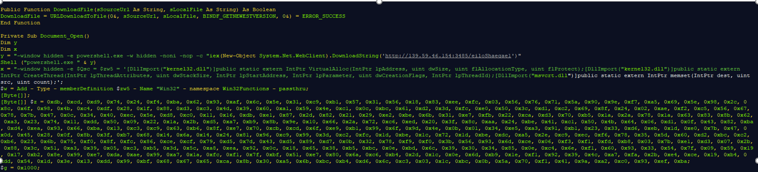
Limitation: Decoding the ‘x’ Code
Followed the same process for the next string but in this case, there were multiple strings concatenated to construct a huge string. After performing multiple decode operation, had to beautify and resolve issues to generate the shell code

Slide 26
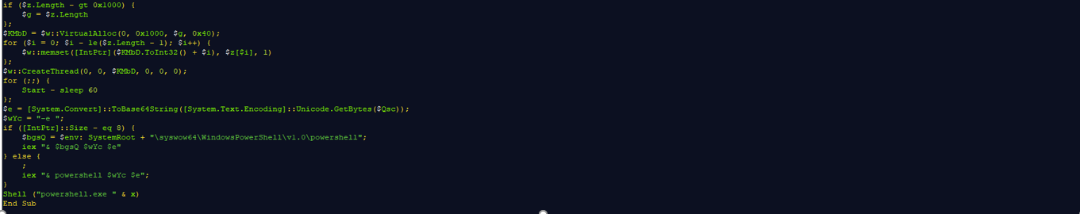
Limitation: Decoding the ‘x’ Code
Followed the same process for the next string but in this case, there were multiple strings concatenated to construct a huge string. After performing multiple decode operation, had to beautify and resolve issues to generate the shell code

Slide 27
OBSERVATIONS
Scan PupyRat malware file
Open document in Notepad++ and notice it’s encoded
Two parameters x and y are found post further analysis which contains strings ending with “==” indicating it’s encoded in base64
Using python for further decoding of x and y parameters
From the decoded macros, it is understood that:
There are two powershell scripts.
The first powershell script is downloading resources for installing pupy rat from a particular IP which is specified in the script.
In the second powershell script, there is a shell code which must be analyzed further, to understand the functionality.
After the powershell script, it is understood that the configuration of the victim system is checked if it is 32 bit or a 64 bit system.
From the next few lines it is understood that a shell with root access is spawned from the second powershell script.

Slide 28
CONCLUSION and MITIGATION
We can conclude that the resources for installing the pupy rat are downloaded from the first powershell script and a shell with root access is spawned through the second powershell script and pupy rat is installed on the victim system.
As the attackers create a backdoor, they can steal sensitive data and files and spy on you anytime even in the future.
The organization should educate the employees about the risks of spear-phishing and shortened links.
The macros in Microsoft Office products should be disabled in order to restrict the attacks that leverage this functionality.
Organizations should also incorporate advanced malware prevention technologies and endpoint threat detection tools as part of their mitigation strategies.

Slide 29
Extension : Android
AndroRAT
AndroRAT is a remote administration tool for android platform
Classified as a malware
AndroRAT allows remote attacker to control a infected device
Easy to use
Gaining in popularity

Slide 30
Setup
VMware Workstation
Windows 10 pro evaluation edition
Java
Python
Pip, Git, Colorama
Android studio
AndroRAT
Hybrid analysis

Slide 31
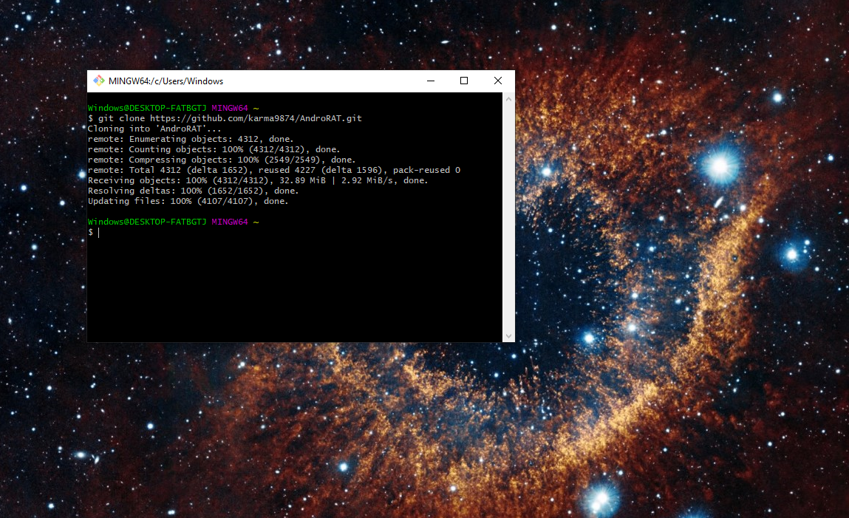

Slide 32
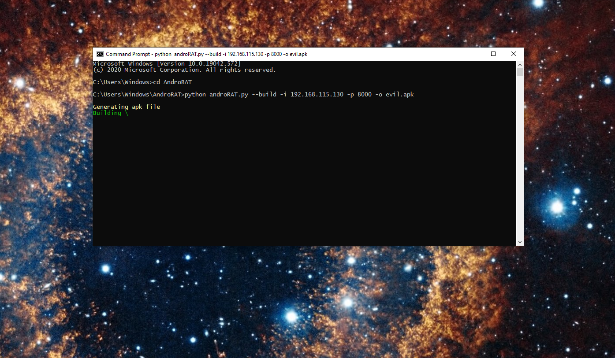

Slide 33
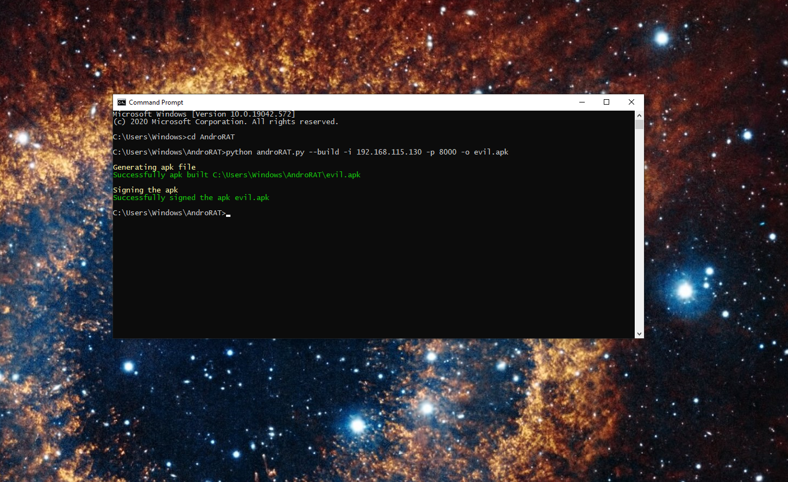

Slide 34
Analysis
Static analysis
Hybrid analysis
Dynamic analysis
AndroSAT

Slide 35
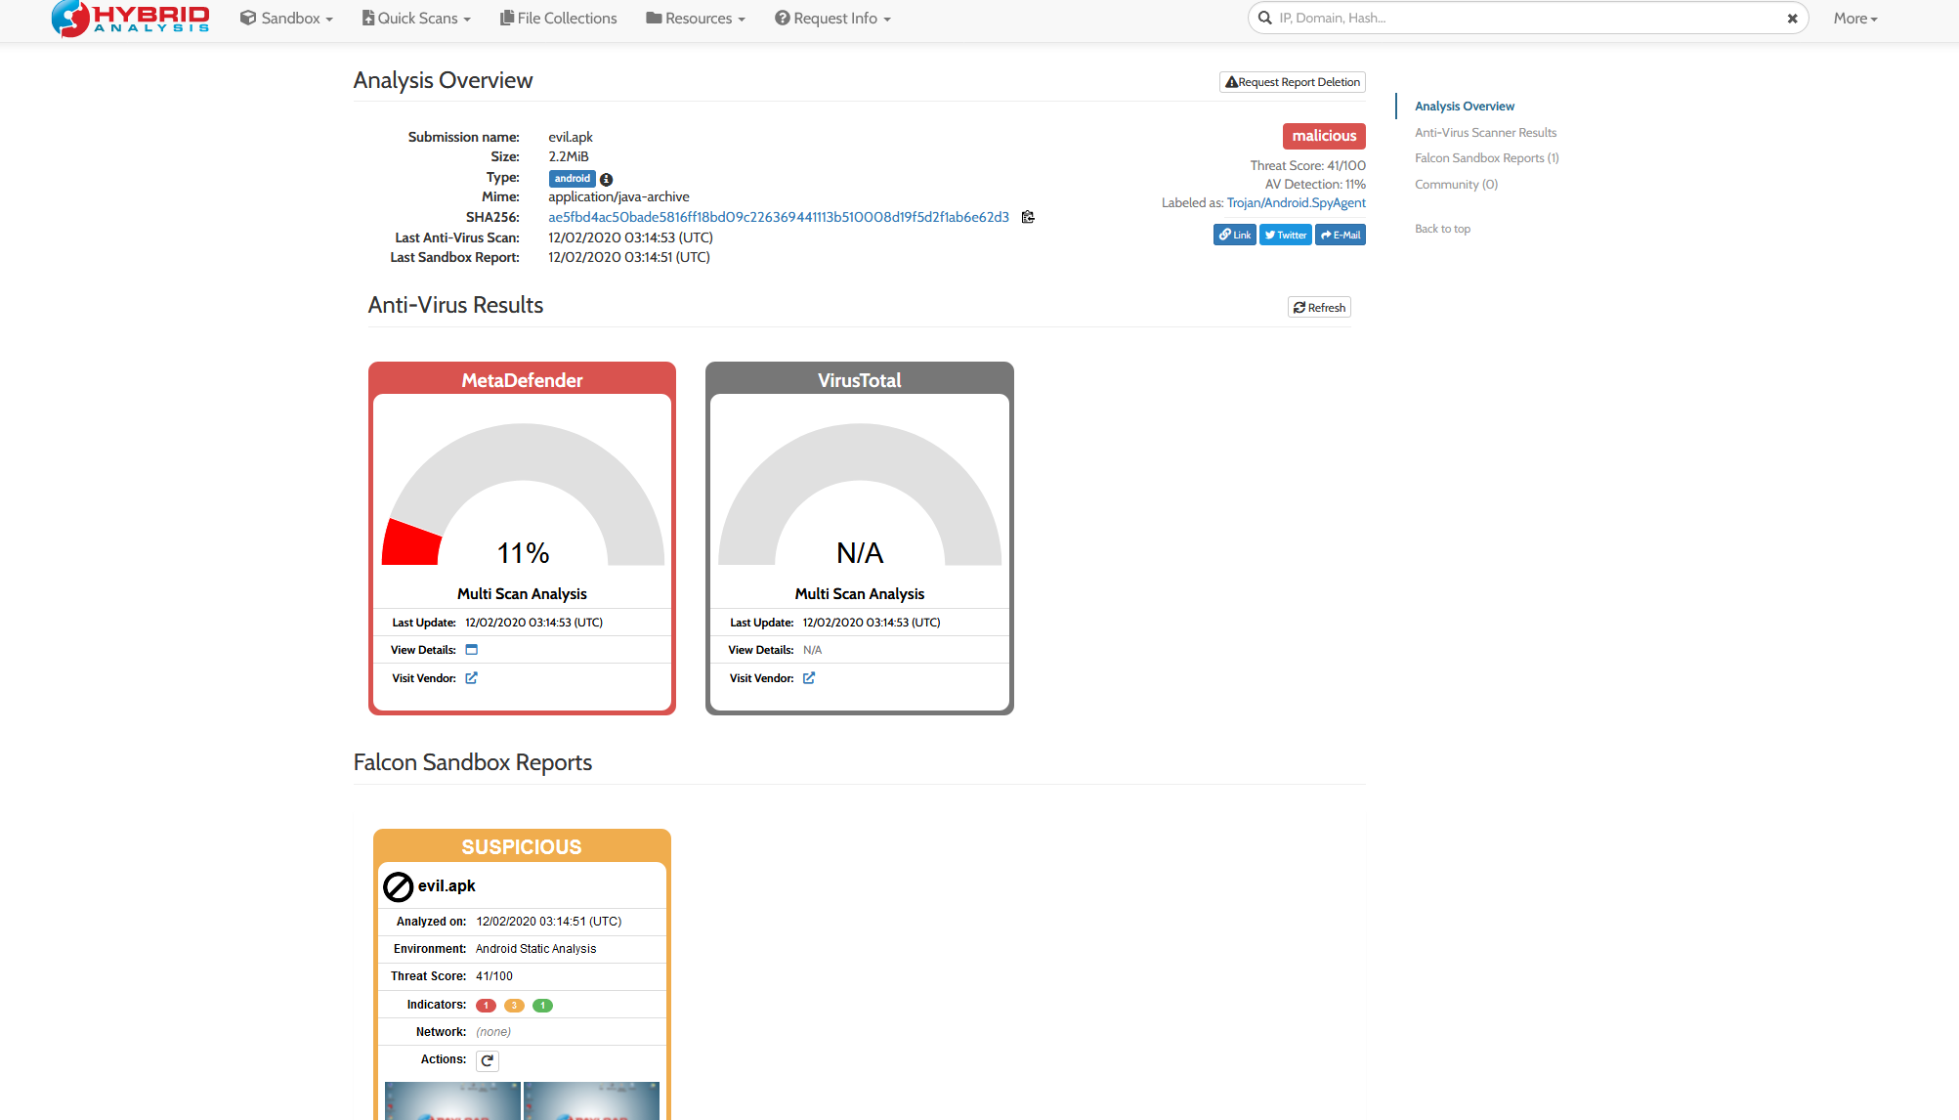
Static Analysis

Slide 36
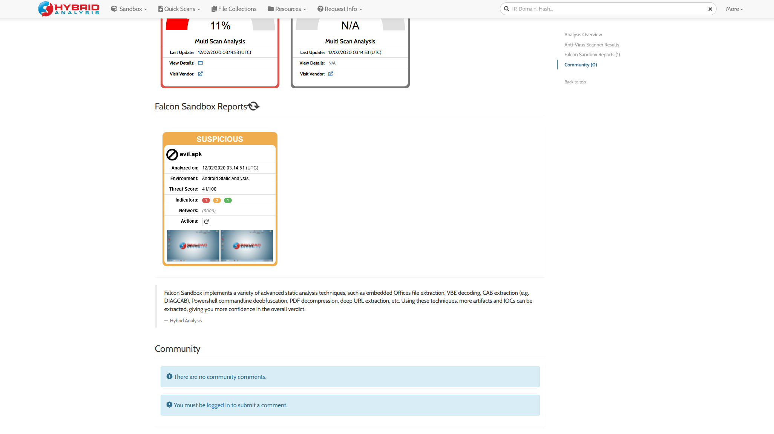

Slide 37
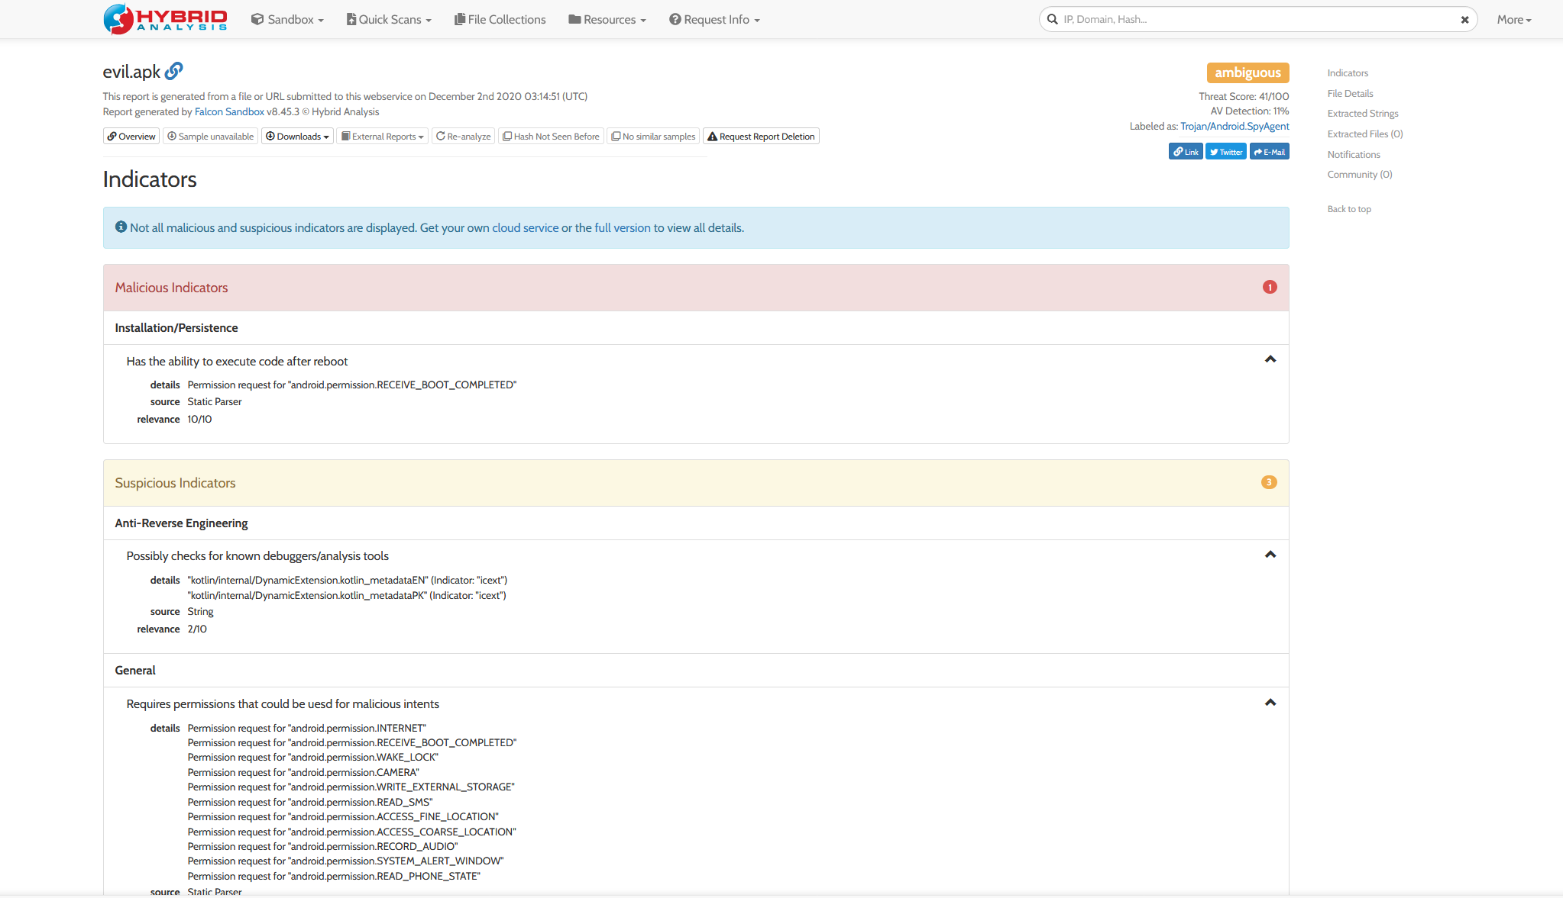

Slide 38
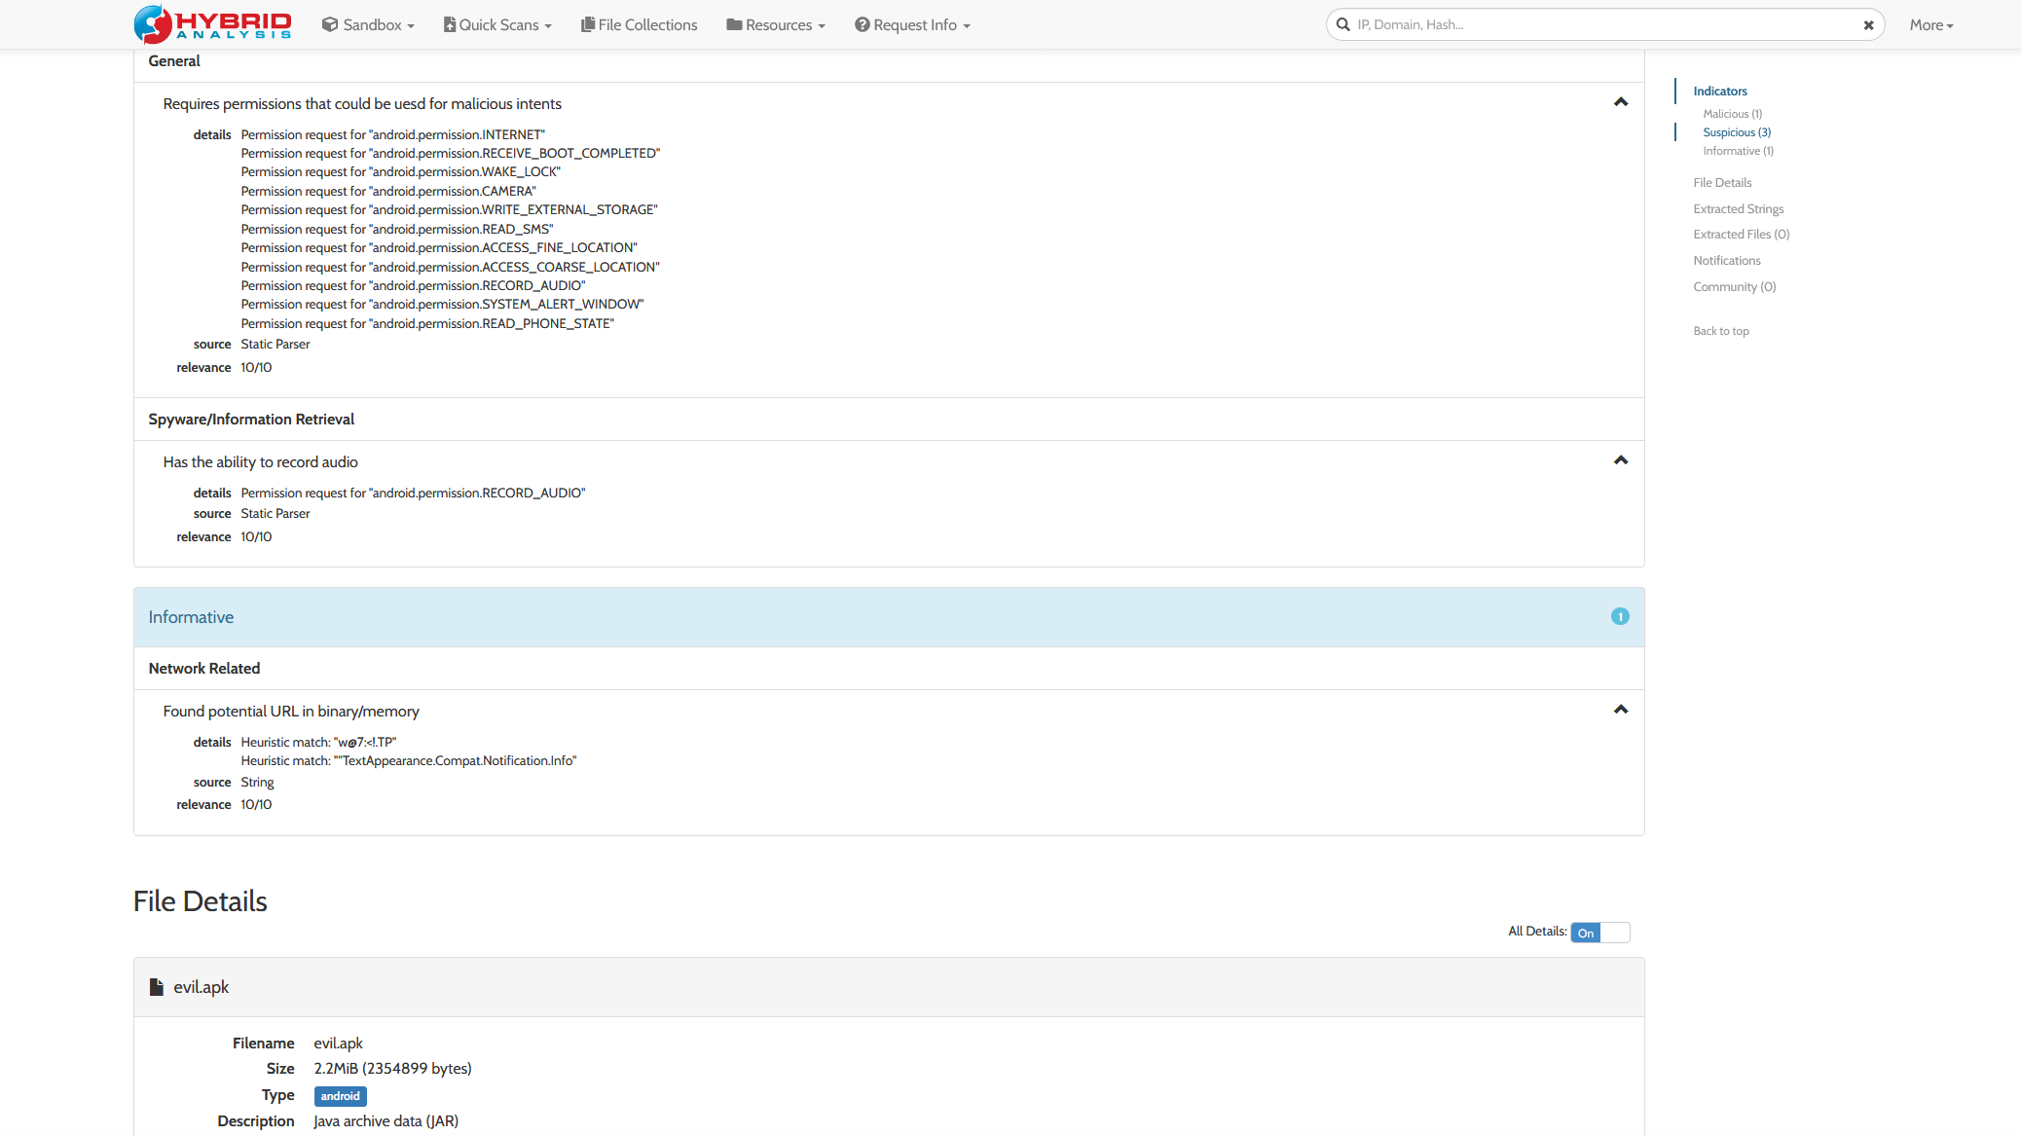

Slide 39
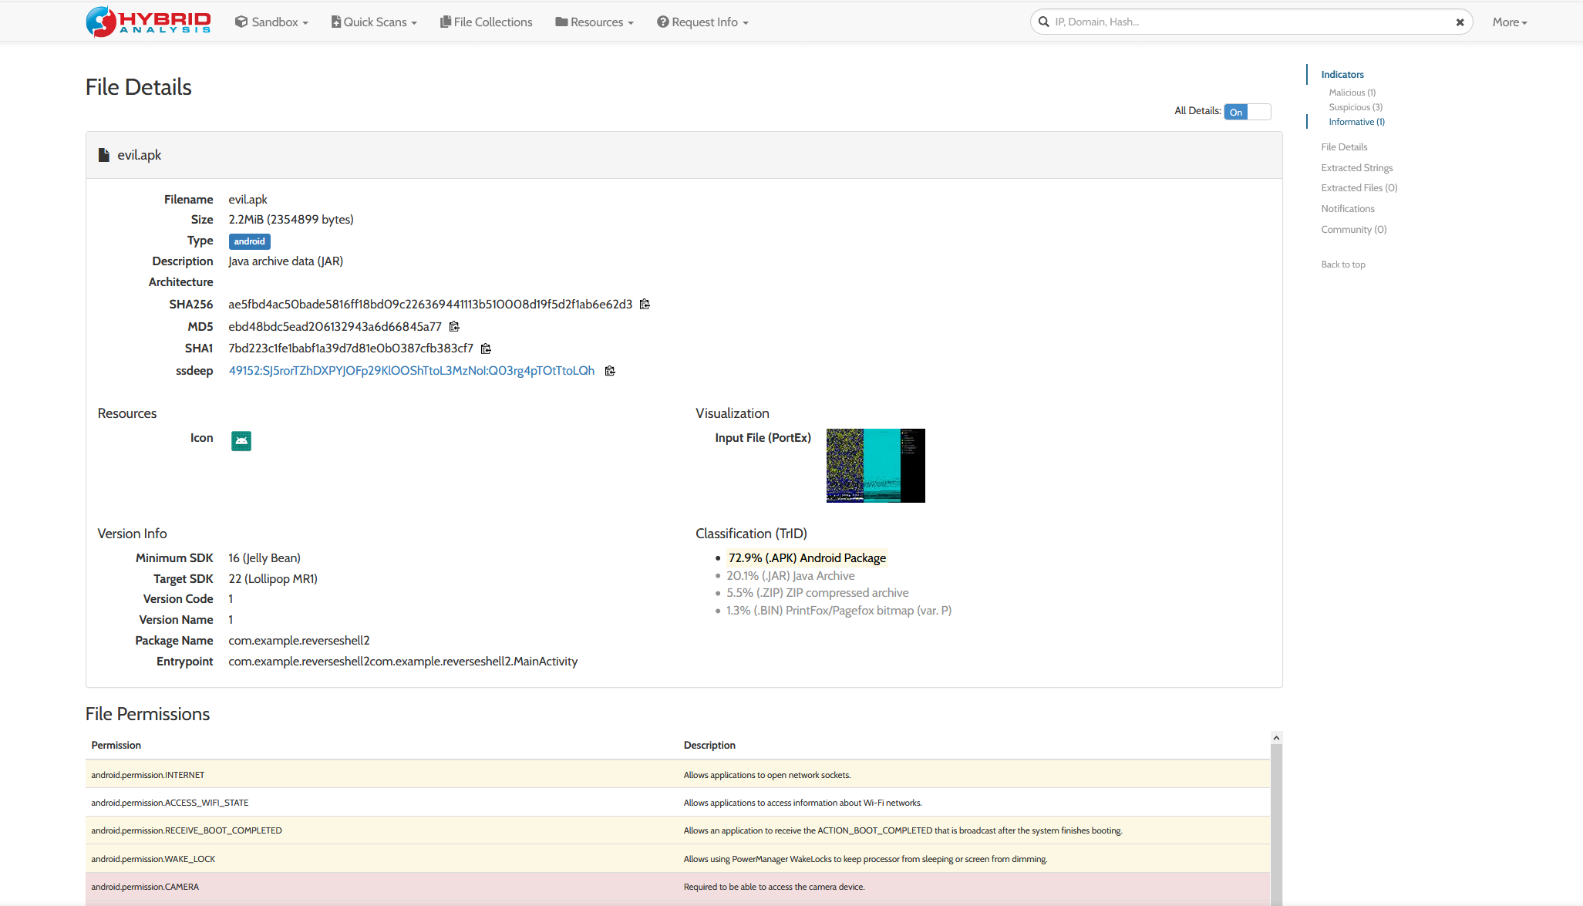

Slide 40
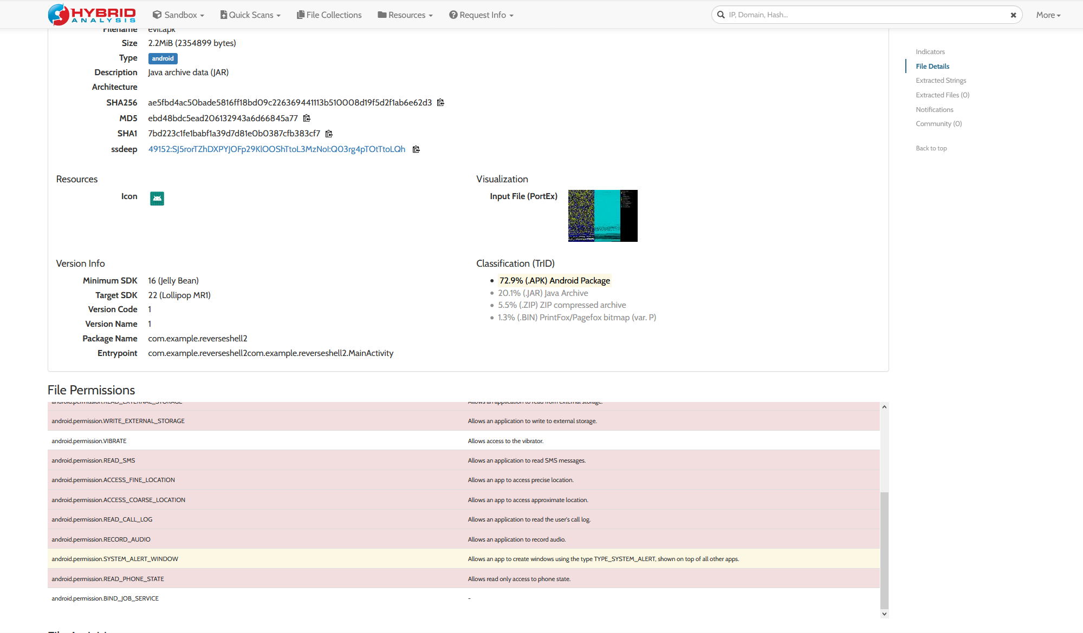

Slide 41
Propagation
Through genuine looking emails
Websites (Loot, Prize winner etc)
MITM
Downloading apps through untrusted sources
Downloading apps not available in certain regions using a website
Phishing attacks

Slide 42
Observations
Difficult for antivirus to detect
Can emulate normal behaviour when running in vm
Modify system parameters
Light footprint
Execute after installation
Code execution after reboot
Inspect analysis tools
Ability to remotely monitor
Collect data and upload to server
User information (IMEI)
Audio (phone calls, audio recordings)
Images (Take a photo, access gallery)
Video (Live video, recorded video)
Text (SMS, notes etc)
Location (Live, saved location info)
Write and read to storage
Read phone state
Notes:
Live location info even though the location is not switched on

Slide 43
Mitigations
Download apps only from trusted sources (Google Play)
Do not open suspicious emails
Do not open malicious websites
Do not open spam messages
Beware of advertisements on apps (Especially social media)
Use a highly tested and rated internet security software
Use common sense
For enterprise have a security policy, perform risk assessment
Deploy security policy based on risk assessment
Avoid public networks

Slide 44
Future Work
Dynamic analysis of AndroRAT
Extract application
Initialize emulator for API monitoring
Install application
Launch application using command line
Launch activity of app using MonkeyRunner
Perform activities and take screenshots using MonkeyRunner
Logs are fed to parser and info is obtained
Information is given in the form of XML and PDF files
Notes:
The monkeyrunner tool provides an API for writing programs that control an Android device or emulator from outside of Android code. ... The monkey tool runs in an adb shell directly on the device or emulator and generates pseudo-random streams of user and system events.

Slide 45
References
https://www.codeproject.com/Articles/325776/The-Art-of- Win32-Shellcoding
http://www.reconstructer.org/
ttps://www.secureworks.com/blog/iranian-pupyrat-bites- middle-eastern-organizations
https://sensorstechforum.com/pupy- rahttps://sensorstechforum.com/pupy-rat-description-and- removal/t-description-and-removal/

Slide 46
References
Android Devices. Validating Security-Enhanced Linux in Android. [Online]. Available: https://source.android.com/devices/tech/security/se-linux.html.
Android Devices. Android Security Overview. [Online]. Available: https://source.android.com/devices/tech/security/.
Android-Apktool: A tool for reverse engineering Android APK files. [Online]. Available: https://code.google.com/p/android-apktool/.
Apk2java: Batch file to automate APK decompilation process. [Online]. Available: https://code.google.com/p/apk2java/
M. Alazab, V. Monsamy, L. Batten, P. Lantz, and R. Tian. Analysis of Malicious and Benign Android Applications. In 32nd International Conference on Distributed Computing Systems Workshops (ICDCSW), 2012

Slide 47


